Slide 1
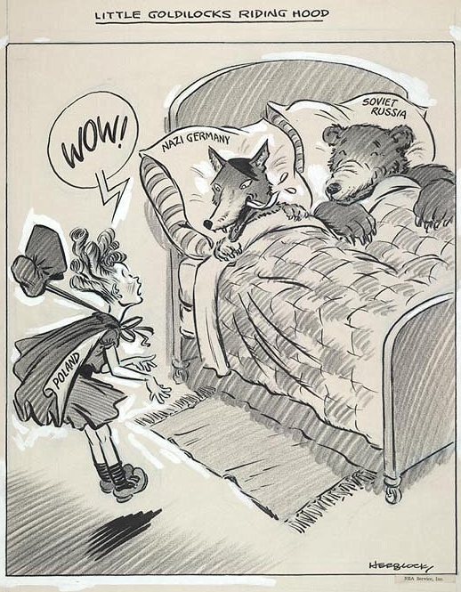
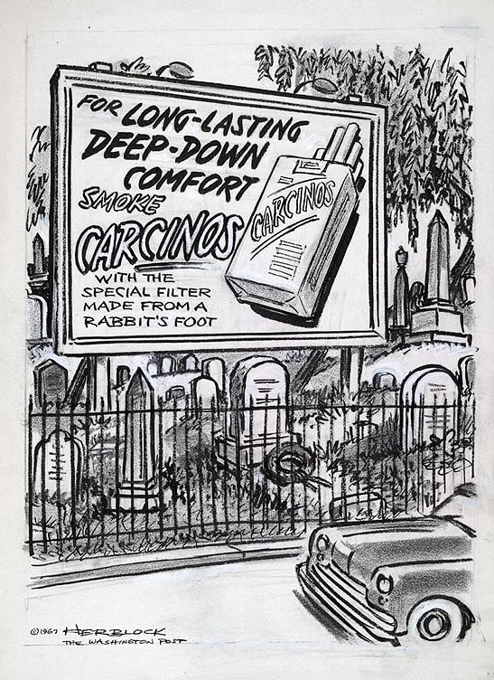
Understanding Political Cartoons
Tim Wulf
Governors State University EDUC 7212
https://sites.google.com/site/twulf62014/home

Slide 2
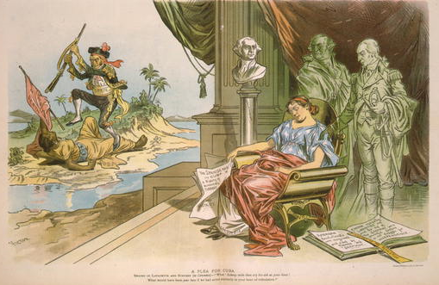
What meaning can you interpret from this cartoon?

Slide 3
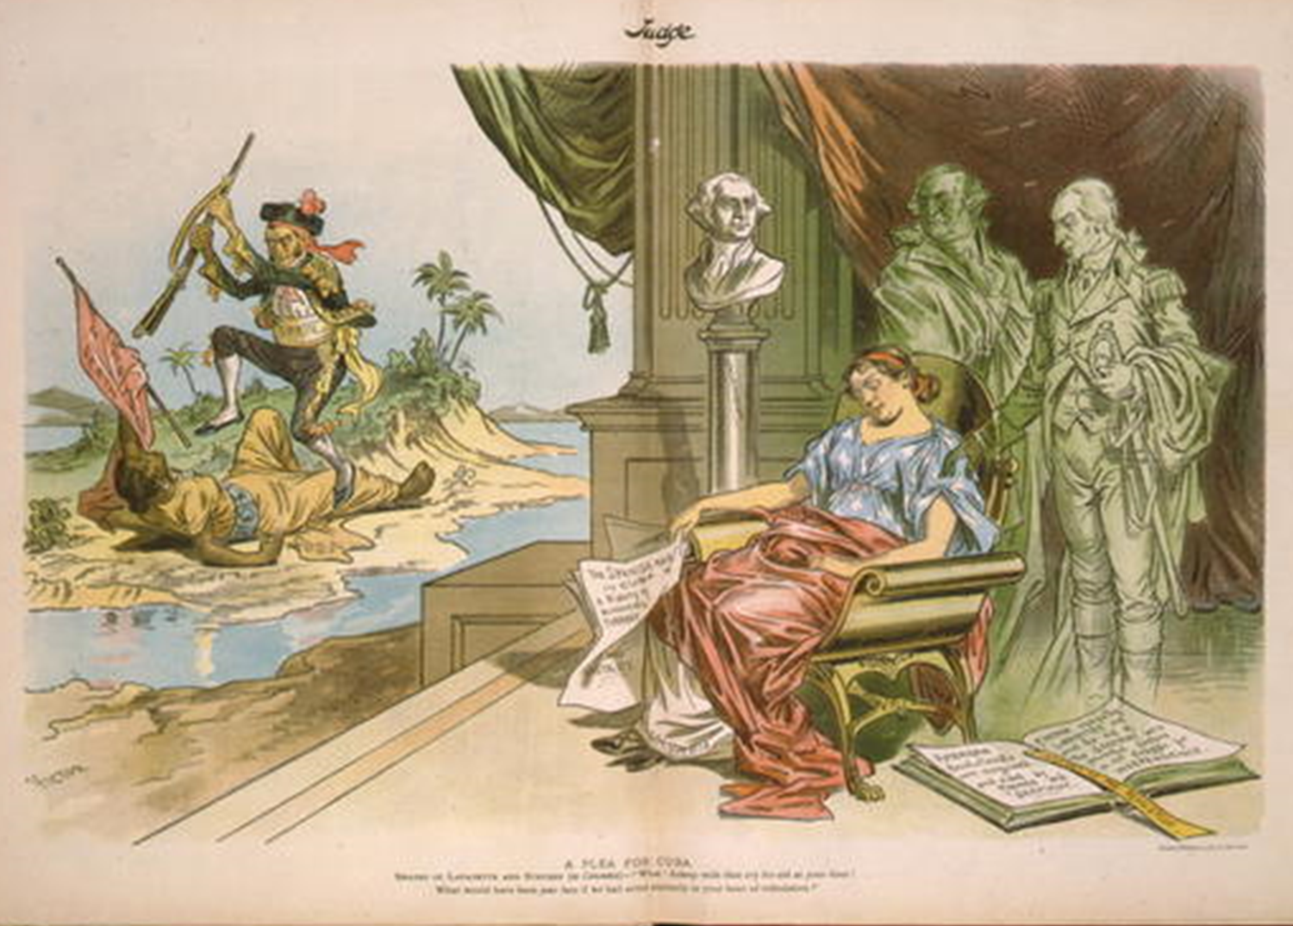
Title: “A plea for Cuba” by Victor Gillam
Judge, Oct. 19, 1895, v. 29, pp. 248-249.
Summary: Cartoon showing sleeping woman "Columbia," Steuben and Lafayette standing behind her, holding document describing Cuba's historic repression by Spain, ignoring sight of man "Spain" beating prone woman "Cuba" who holds banner "Liberty or death."
Reproduction Number: LC-USZC4-4130 Rights Advisory: No known restrictions on publication.
Repository: Library of Congress Prints and Photographs Division Washington, D.C. 20540 USA

Slide 4
Roadblocks to Understanding
What prevented you from gaining a full understanding of the cartoon?
Students may lack…
experience with political cartoons.
familiarity with the structure of cartoons.
knowledge of cultural connections and analogies.
recognition of stereotypes and symbols.
ability to identify irony.
skills to make inferences.
understanding of the cartoon’s context.
We must provide them with the tools necessary to overcome these roadblocks. We must put our ELA skills to work!

Slide 5
Political Cartoons
Political cartooning is an art form used to express opinion. These opinions could be about anything, but normally address political, economic or social issues. Political cartoonists use certain techniques (or tools) to get their point across. They don’t use all of these tools every time. They are kept in a “tool box” and used whenever needed.
These tools allow the artist to…
Focus on a single, clearly defined topic.
Simplify or exaggerate issues for easy
understanding
Use symbolism to help their reader identify
topics easily
Use humor or irony to express opinion
Make historical and cultural references
Express opinions by using stereotypes
Use analogies that compare the topic to
historic events or other well known stories.

Slide 6
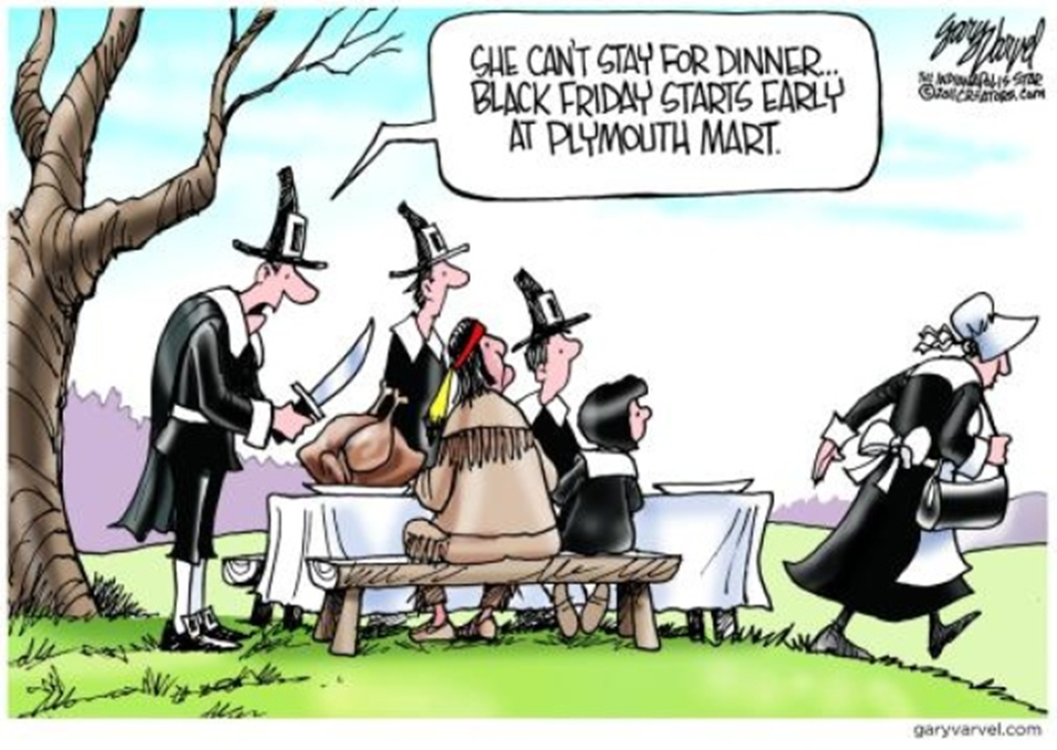
Reading Cartoons
Artist’s
Tool
Box
Topic
Symbols
Simplification or Exaggeration
Irony/Humor
Stereotype
Analogy
Historical & Cultural
Connections
Identify as many artist tools as you can in this cartoon. Then try to determine the point being made by the artist.

Slide 7
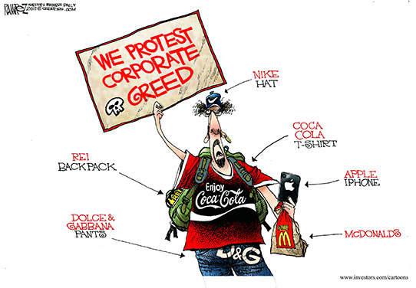
Artist’s
Tool
Box
Thanksgiving shopping.
Pilgrim clothing
Native American clothing
Turkey
Purse
Topic
Symbols
Simplification or Exaggeration
There were more people at the first Thanksgiving.
There were no stores in the Plymouth colony.
Irony/Humor
Clothing styles, women going shopping
Stereotype
The Pilgrims celebrated the first Thanksgiving and modern Americans sometimes value shopping more than the holiday.
Analogy
It compares modern Thanksgiving habits to the past.
Historical & Cultural
Connections

Slide 8
“UNCOVER” ACTIVITY
On the next screen you will view another political cartoon. Unlike the previous cartoons, you will not be viewing the entire image at one time. Instead, you will be shown the image one piece at a time until the whole cartoon is uncovered.
You and your partner will receive a “Political Cartoon Analysis” sheet and “Image Analysis” sheet. Each of you will be in charge of completing one sheet—be sure to discuss and help each other during the activity.

Slide 9
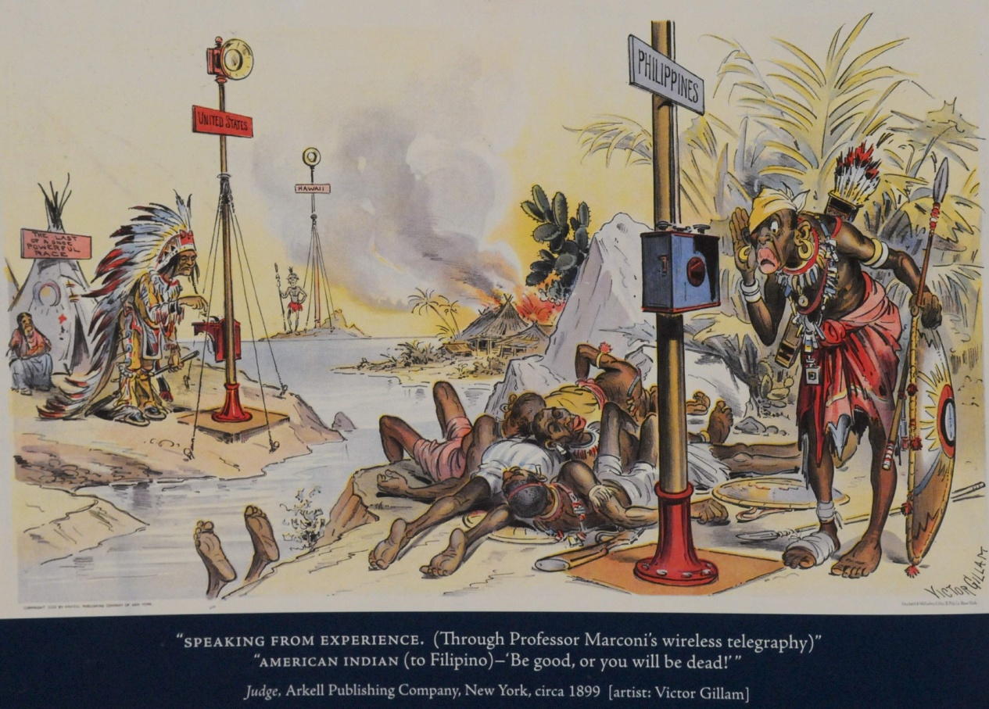

Slide 10
Historical Reference
The sign says “Last of a once powerful race.”
Topic/Meaning
In 1898 the U.S. won control of the Philippines as a result of the Spanish American War. Over the next 2-3 decades, the U.S. attempted to control this new colony—frequently through horrible violence. MANY Americans opposed this policy.
Symbols
Tepees, feathers, shields, palm trees.
Symbols
Signs, tepees, feathers, shields, palm trees.
Analogy
The experiences of Native Americans are being compared to those of the Filipinos.
Simplification
Generic characters and setting are used. Distances are greatly reduced.
Historical Reference
I know that Native Americans were pushed off their land and killed by American settlers.
Irony
What happened to the Indians is about to happen to the Filipinos.
Irony
What happened to the Indians is about to happen to the Filipinos.
Historical Reference
The title is “Speaking from Experience” and the Native Americans are telling the Filipinos to “be good, or you will be dead.”
Stereotypes
Indians in clothing, Filipino facial features and culture
Stereotypes
Indians in clothing, Filipino facial features and clothing
Historical Reference
Native Americans are talking with Filipinos over the telegraph.

Slide 11
Understanding Political Cartoons
Part II
The Road to Revolution

Slide 12
Colonial Cartoons
We will now use our analysis tools to study four cartoons created between the French & Indian War and the American Revolution.
As you study the cartoons, keep this focus question in mind. It will be asked again at the end of the activity.
What was the colonial opinion of British tax laws and how did they make their feelings known?
Each station requires the completion of an “Image Analysis” sheet and a “Political Cartoon Analysis” sheet. You should work as a team, but each person is responsible for completing a form.
At the end of the activity each partner should have two “Image Analysis” sheets and two “Political Cartoon Analysis” sheets done in their own handwriting.
You will have 15 minutes at each station.

Slide 13
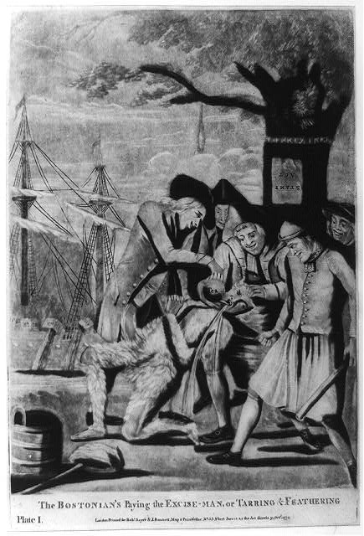
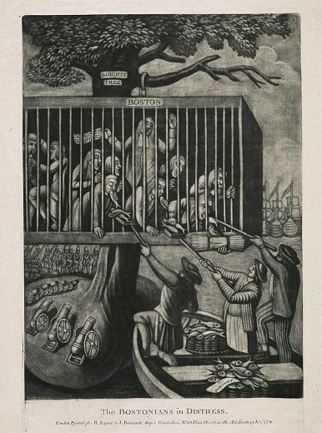
“The Bostonians in Distress”
This cartoon shows the affect of the Intolerable Acts on Boston. The people of Boston are shown in a large cage hanging from the “Liberty Tree”. British cannons, soldiers and ships surround the tree. This symbolizes the fact that the port of Boston was closed as punishment for the Tea Party.
The men in the boats are giving fish to the caged men. There is also a document of some sort in the boat and another held by a man in the cage. These items represent the aid that was sent from other colonies and the communication that was kept open by the committees of correspondence.
“The Bostonian’s Paying the Excise Man or Tarring and Feathering”
This image shows Bostonians, possible members of the Sons of Liberty, carrying out a violent attack on a tax collector. He has been tarred and feathered and is having hot tea forced down his throat. The tar bucket can be seen in the lower left hand corner.
Other symbols of colonial protest include a noose hanging from the tree, the Stamp Act posted upside-down on the “Liberty Tree”, a club in one man’s hand and what is probably tea being dumped off the ships in the background.

Slide 14
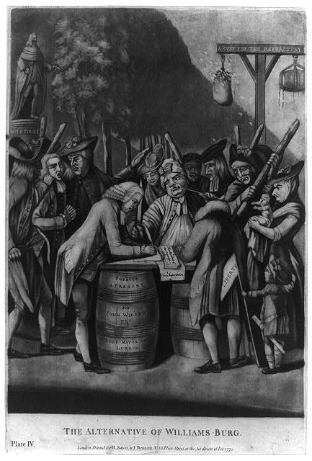
“The Alternative of Williamsburg”
This cartoon shows a Virginia Loyalist being forced to sign a document of some sort.
Another man has been seized by these “liberty men”. He apparently is being led to a gallows in the background. One of the men taking him away is holding a pair of scissors. A barrel of tar and bag of feathers are hanging from the gallows.
A young boy is holding a “Liberty” flag.
The top of the gallows says “A Cure for the Refractory”

Slide 15
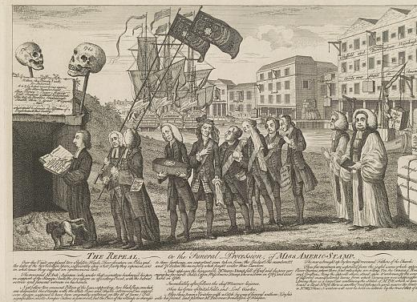
“The Repeal”
This cartoon shows a funeral procession for the recently canceled Stamp Act. It is being buried in a vault containing other canceled laws that angered British subjects in the past. The members of the procession are the leaders who had supported the law. The man carrying the coffin is called “Mr. George Stamp”.
To the far right are boxes of stamps and goods returned from America as a form of protest.
The ships in the London harbor are now set to resume trade since the hated law has been repealed.
A statue of Mr. Pitt (a politician in support of the repeal) is being loaded on a boat for America.
Notice the dog lifting his leg on the leader of the procession.

Slide 16
What was the colonial opinion of British tax laws and how did they make their feelings known?
Use the information you have gathered on your analysis sheets to respond to the focus question.
Your response must include at least four supporting details found in the cartoons studied today. Your details must come from at least two different cartoons.
This response will require between a half and full page of writing.
Your response and all analysis sheets are due at the beginning of our next class.

Slide 17
Feedback
Has this session given you greater insight, knowledge or comfort in using political cartoons or other primary sources in your classroom?
How might you use this in your own instruction?
What suggestions or ideas do you have for me?
https://sites.google.com/site/twulf62014/home
twulf@psd202.org

Slide 18
Sources
Library of Congress | Library of Congress. (n.d.). Library of Congress Home | Library of Congress. Retrieved June 24, 2014, from http://www.loc.gov
Little Goldilocks Riding Hood http://www.loc.gov/pictures/item/00652177/
For long-lasting deep-down comfort smoke Carcinos with the special filter made from a rabbit’s foot http://www.loc.gov/pictures/item/00652232/
The Bostonians in distress http://www.loc.gov/pictures/item/2011647025/
The Bostonians paying the excise-man or tarring & feathering
http://www.loc.gov/pictures/item/2004673302/
The alternative of Williams-burg
http://www.loc.gov/pictures/item/97514624/
The repeal, or the funeral of Miss Ame-Stamp
http://www.loc.gov/pictures/item/2006678564/
A Plea for Cuba http://www.loc.gov/pictures/item/95523060/

Slide 19
Sources
Final Update #16: The Week in Editorial Cartoons - BP's Brilliant PR Move. (n.d.). Final Update #16: The Week in Editorial Cartoons - BP's Brilliant PR Move. Retrieved June 24, 2014, from http://www.dailykos.com/story/2010/05/25/868486/-Final-Update-16-The-Week-in-Editorial-Cartoons-BP-s-Brilliant-PR-Move#
Plymouth Mart. (n.d.). Cagle Post RSS. Retrieved June 24, 2014, from http://www.cagle.com/2012/11/plymouth-mart/
Browse Items (102 total). (n.d.). Omeka RSS. Retrieved June 24, 2014, from https://omeka.jmu.edu/main/items/browse?advanced%5B0%5D%5Belement_id%5D=45

