Slide 1
Let’s Agree to Disagree: The Common Core and Collaborative Discussion
Teresa Kruger, Ed.D.
Belvidere North High School
tkruger@district100.com

Slide 2
Goals for Session
What are collaborative discussions and how does the Common Core impact discussions?
What preparation needs to occur prior to collaborative discussions?
What are some different models for discussions?

Slide 4
What are Collaborative Discussions?
Rich, structured conversations around topics and/or texts
Academic conversations requiring problem-solving
Meaningful discussions that require students to respond to ideas shared by peers

Slide 5
Where do Collaborative Discussions fit in the Common Core?
ELA Speaking & Listening Standards
CCSS.ELA-LITERACY.SL 6 -12.1
Initiate and participate effectively in a range of collaborative discussions (one-on-one, in groups, and teacher-led) with diverse partners on grades 6-12 topics, texts, and issues, building on others' ideas and expressing their own clearly and persuasively.

Slide 6
How are Collaborative Discussions different under the Common Core?

Slide 8
Shift in Discussions
We are more accountable for the talk in our classrooms
Need an increase in purposeful, deep conversations in the classroom on a daily basis
Based on evidence, claims, justification, and counter-claims

Slide 9
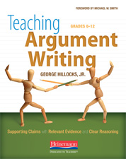
Notes:
Idea from Teaching Argument Writing: Grades 6-12 (2011)

Slide 10
Evidence-Based Discussions
After studying the questions:
How was Amy apparently killed?
Is there evidence of a violent struggle?
Was she robbed?
Did she know her killer?
Could this have been a crime of passion?
Who killed her?

Slide 11
How to Prepare for Collaborative Discussions
Create norms (guidelines) for discussion
Choose topics / texts worthy of discussion
Prepare students for discussion
Use a discussion model

Slide 12
Creating Norms for Discussions
CCSS.ELA-LITERACY.SL.9-10.1.B
Work with peers to set rules for collegial discussions and decision-making (e.g., informal consensus, taking votes on key issues, presentation of alternate views), clear goals and deadlines, and individual roles as needed.

Slide 13
Creating Norms for Discussion
Spend time setting them up & practicing
Involve students in the creation
Use their own experiences as participants in discussion
Post and monitor norms
Notes:
see handout - pg.

Slide 14
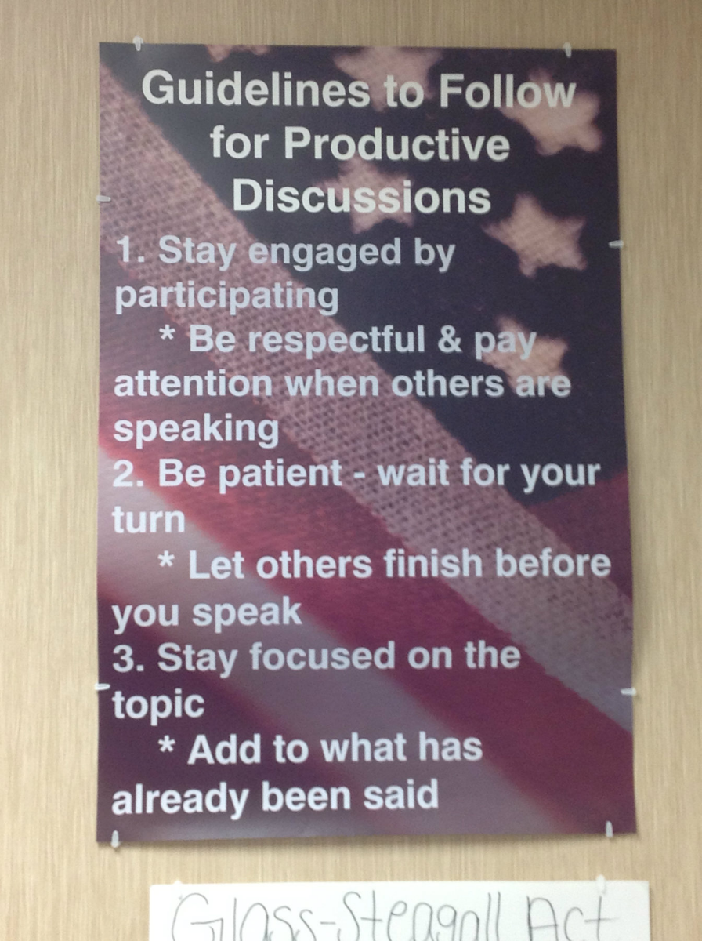
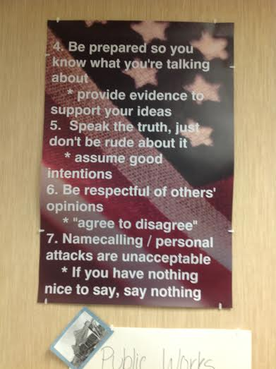

Slide 15
How to Prepare for Collaborative Discussions
Create norms (guidelines) for discussion
Choose topics / texts worthy of discussion
Prepare students for discussion
Use a discussion model

Slide 16
Choose Topics Worthy of Discussion
Enduring Issues:
•Fundamental, enduring questions that confront societies throughout time and across cultures
•Focus on historical events that raise persisting questions about the social good

Slide 17
Persistent Issue | Possible Topics | Topic-Specific Issue
When are citizens justified in resisting governmental authority? | •American Revolution •U.S. Abolitionist Movement | Revolution: Were the colonists justified in revolting from Great Britain?
What actions are justified in the interest of national or community security? | •Native American Policies •U.S. WWII Homefront Policies | Native Americans: Were European-American policies toward Native Americans justified?
When are nations justified in intervening in the affairs of other countries? | •Mexican War •Vietnam | Mexican War: Should the U.S. be praised or condemned for its foreign policy towards Mexico?

Slide 18
Choose Worthy Topics
Can be integrated into existing curriculum
Entire curriculum revolves around enduring issues

Slide 19
Theme | Essential Question:
Growth of Government Powers | How involved should the federal and state governments be in the lives of its citizens?
Immigration | What should be the United States’ immigration policy?
Expansion of the United States | Is acquiring and maintaining an empire essential to America’s national interests?
War and Foreign Policy | What should the role of the United States be in the world? When is war justified?
Liberty v. Security | When should you have to sacrifice your personal liberties for the security of the nation?
Social Equality | How far has the United States come to fulfill the promise of “equality for all?”
Economic Equality | To what extent is the federal government responsible for the welfare of the individual?
Technology | Is progress good?

Slide 20
How to Prepare for Collaborative Discussions
Create norms (guidelines) for discussion
Choose topics / texts worthy of discussion
Prepare students for discussion
Use a discussion model

Slide 21
Prepare Students
CCSS.ELA-LITERACY.SL.11-12.1.A
Come to discussions prepared, having read and researched material under study; explicitly draw on that preparation by referring to evidence from texts and other research on the topic or issue to stimulate a thoughtful, well-reasoned exchange of ideas.

Slide 22
Preparing Students for Discussions
Provide a common base of information for class discussion (handout, reading, video)
use class time
assign for homework - require an entrance ticket to participate
Notes:
multiple perspectives on the issue / topic

Slide 23
Preparing Students for Discussion
Have students do structured, critical pre-reading / previewing
Give students a specific task as they are reading
answering questions
generating their own questions
Craft good discussion questions
require students to analyze / evaluation the text
have no right answer; allow students to form an interpretation, solve a problem or use textual evidence to support
Notes:
Create questions that force students to analyze the text and dive deeply into it.

Slide 24
How to Prepare for Collaborative Discussions
Create norms (guidelines) for discussion
Choose topics / texts worthy of discussion
Prepare students for discussion
Use a discussion model

Slide 25
Use a Discussion Model
Chose a model based on your outcome
Teach the format
Practice it with students
Get feedback from students

Slide 26
Collaborative Discussion Model
Carousel Brainstorming
groups of 3-4
different colored marker
each group start at a different chart paper
3-4 minutes to discuss the question & respond on the chart paper
Move to next chart paper when time expires

Slide 27
Putting it All Together
https://www.teachingchannel.org/videos/reading-like-a-historian-taking-positions

