Slide 1
Illinois YMCA Youth and Government “Democracy must be learned by each generation”
Presenter: Kristin Miller, Interim Executive Director

Slide 2
Illinois YMCA Youth and Government
Mission
National Program
History in Illinois
2013-2014 Highlights
Program Details
Getting Involved
Questions

Slide 3
Mission
To provide the youth of Illinois with an immersive educational experience to inspire and promote life-long leadership, ethics, responsible citizenship and self-confidence through participation in a unique model state government program.

Slide 4
National Y&G Program
Founded in 1936 in New York as an opportunity for youth leaders to come together to discuss and debate real legislative issues
Currently 38 states with a Youth and Government Program
Council on National Affairs (CONA) held each July in the Blue Ridge Mountains

Slide 5
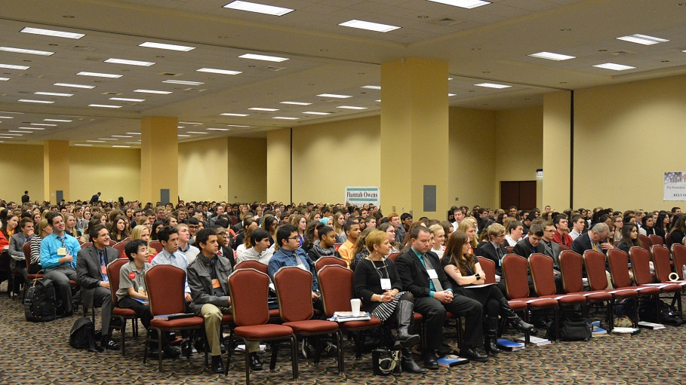
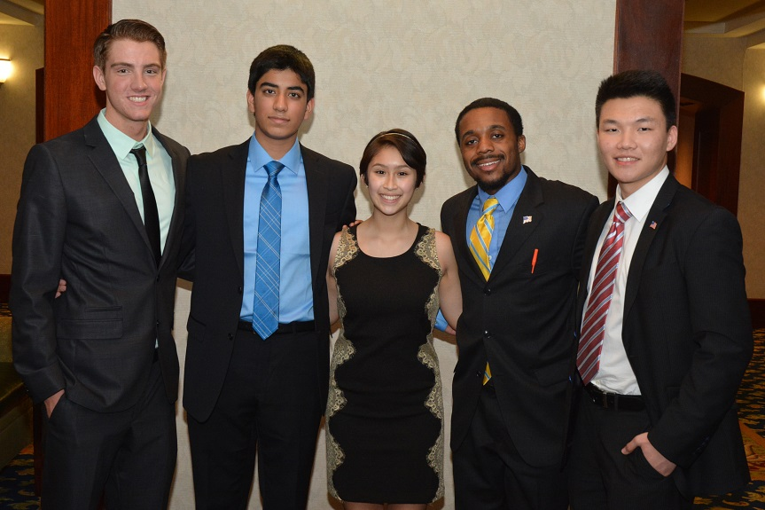
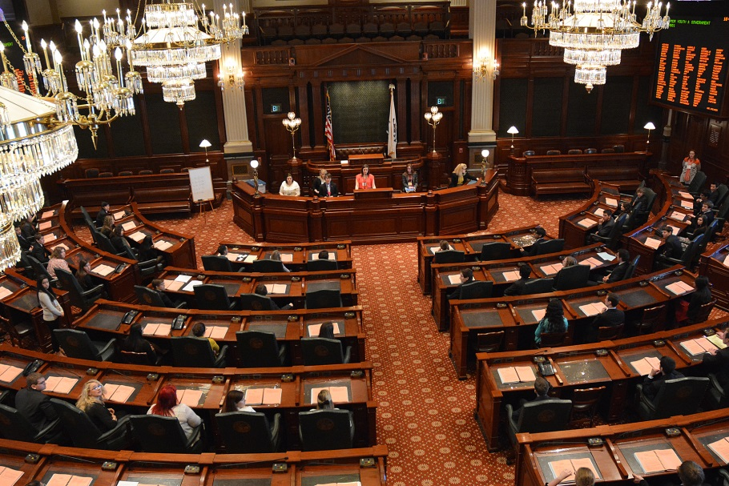
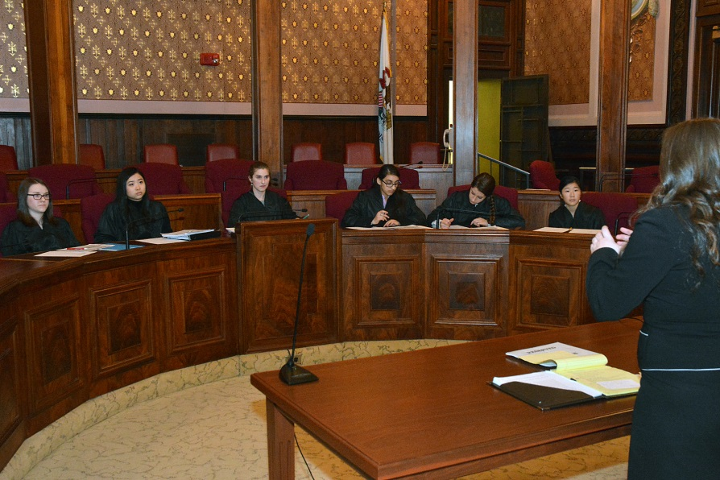
Springfield

Slide 6
History in Illinois
Founded in 1949
National YMCA leaders wanted to create a program that adhered to the reality of Illinois government and allowed youth to experience the process
Governor Adlai Stevenson endorsed the first assembly as “…an ideal foundation for citizenship training…predicated on the sound proposition that experience is the best teacher.”

Slide 7
History in Illinois
Today, the founders vision is still evident as six months of pre-legislative business prepares students for the General Assembly weekend at the Springfield Capitol
Judicial Program added in 1974-75
Late 80’s and early 90’s saw the addition of the Lobbyist Program as well as Video and Newspaper Press

Slide 8
2013-2014 Program Highlights
933 delegates participated, representing 34 high schools and YMCAs – including 8 McCormick Foundation Democracy Schools
550 Legislators wrote 156 bills; 85 were passed and signed by the Youth Governor
142 Lobbyists supported those bills through testimony and writing position papers
83 Legislative Assistants participated in the State Issues Forum and assisted bill groups
37 Teams of Attorneys presented appellate briefs and oral arguments

Slide 9
2013-2014 Program Highlights
The Media Corps produced our newspaper The Observer, online and in print, and 2 nightly Capitol News Update television newscasts
Youth and Government encourages delegates to become engaged citizens and active members of society. Y&G Alumni are:
30% more likely to register to vote
32% more likely to actually vote
26% more likely to work on community issues
12% more likely to serve as a member of a Board
63% more likely to get a college degree

Slide 10
Program Details
Legislative
Judicial
Lobbyists
Legislative Assistants
Media Corps

Slide 11
Legislative
Delegates that are Juniors or Seniors may serve as legislators
Bill Groups are comprised of 3-4 students
Students may run for elected offices including:
Governor
Lt. Governor
Secretary of State
Presiding Officer
Committee Chairs

Slide 12
Judicial
Delegates that are Sophomores, Juniors and Seniors may serve as Attorneys
Elect Chief Justice
Participate in a mock trial
Create an Appellate Bench Memo and Oral Argument
Work with volunteers that are attorneys to learn the legal process
Judicial Review

Slide 13
Lobbyists
Delegates that are Freshmen, Sophomores, Juniors or Seniors may participate as Lobbyists
Elect Executive Director of the Lobbyists
Create Lobbyist Position Papers that support a specific Bill
Participate in Special Committee
Participate in Mock Committee Sessions

Slide 14
Legislative Assistants
Delegates that are Freshmen, Sophomores, Juniors or Seniors may be Legislative Assistants
Supervise and execute election process
Support bill groups by providing additional research to lobbyists and legislators as they work to get bills passed in Springfield
Participate in State Issues Forum
Research topics
Write and present proposal during the Springfield weekend

Slide 15
Media Corps
Students can participate as a member of the newspaper or video press
Newspaper staff work on stories at Pre-Leg I and II and produce Friday, Saturday and Sunday copies of The Observer in Springfield
Youth and Government Video Press collaborates with Free Spirit Media to write and produce two telecasts of Capitol News Update in Springfield

Slide 16
2014-2015 Calendar
Pre-Leg I
Friday, November 7th
Section A: Neuqua Valley High School
Section C: Williamsville High School
Section D: Sesser High School
Saturday, November 8th
Section B: Eisenhower High School

Slide 17
2014 – 2015 Calendar
Pre-Leg II
Friday, December 5th
Region I – Lake Park High School
Saturday, December 6th
Region II – Eisenhower High School
Region III – Williamsville High School
Springfield Assembly - March 20-22, 2015

Slide 18
Program Fees
$340 per delegate and advisor
What does the fee cover?
Pre-Leg I and II
Housing and Food for Springfield Weekend
Financial Assistance Available

Slide 19
Getting Involved
Who can start a delegation?
When can we start?
How do we organize a delegation?
Can I volunteer?
Contact Julie at julie@ilymcayg.org or call the office at (630) 833-9622

Slide 20
Questions

Slide 21
Illinois YMCA Youth and Government
“…It recognizes that youth…alert, conscientious, educated – can lead the way to better government and to the realization of all our high hopes for the future.”
---Gov. Adlai Stevenson, 1950 Bill Book

