Slide 1
Locating and Curating Online Primary Sources
Dr. David W. McMullen
Dr. Sherrie C. Pardieck
Dr. Dean A. Cantu

Slide 2

Introduction to the Teaching with Primary Sources Project
Federally funded project of Library of Congress to highlight resources of Library of Congress Website
Designed to prepare teachers to access, use, and produce curriculum using the digitized primary source materials from the Library of Congress
Four Illinois Universities

Slide 3
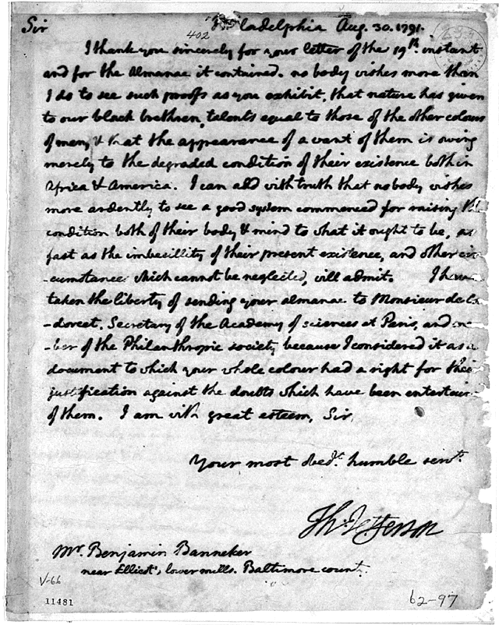
What are Primary Sources?
Original records of people, places, and events.
Examples include:
  Documents

Slide 4
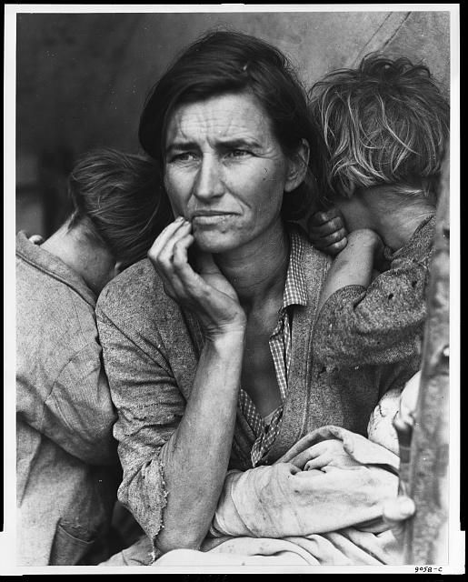
What are Primary Sources?
Original records of people, places, and events.
Examples include:
  Documents
  Photos

Slide 5
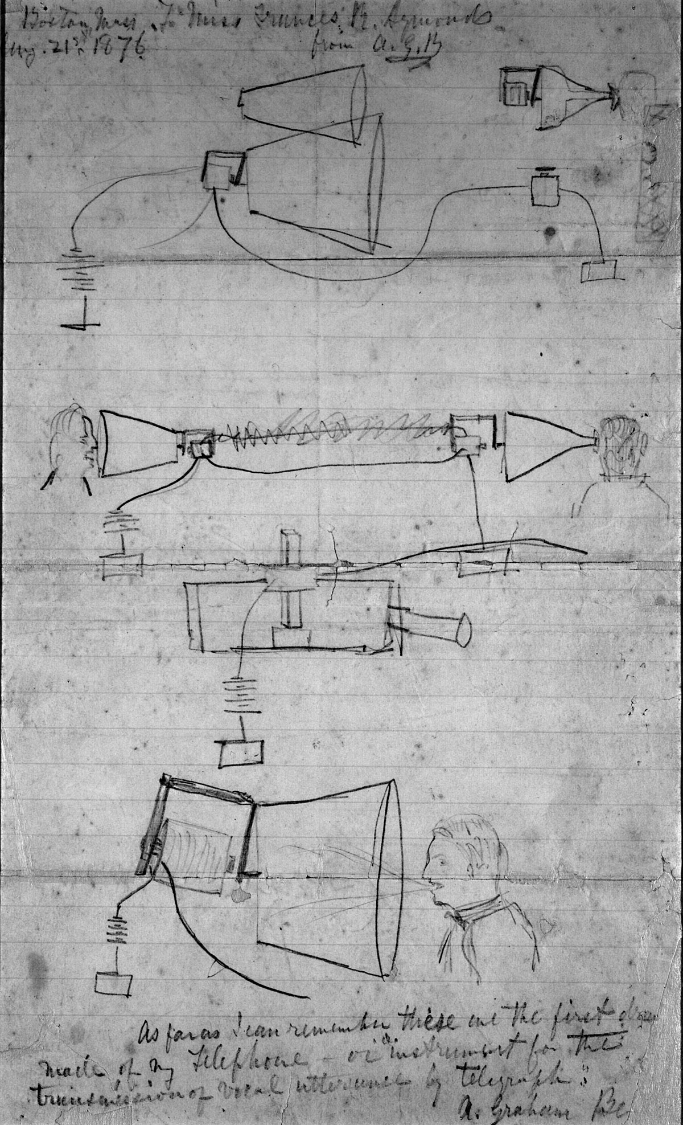
What are Primary Sources?
Original records of people, places, and events.
Examples include:
  Documents
  Photos
  Drawings

Slide 6
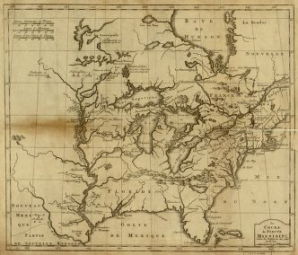
What are Primary Sources?
Original records of people, places, and events.
Examples include:
  Documents
  Photos
  Drawings
  Maps

Slide 7
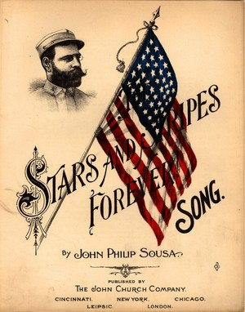
What are Primary Sources?
Original records of people, places, and events.
Examples include:
  Documents
  Photos
  Drawings
  Maps
  Music

Slide 8
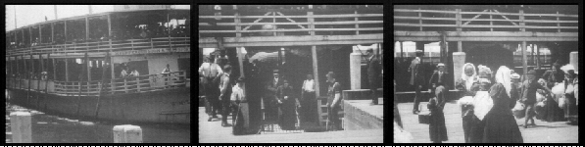
What are Primary Sources?
Original records of people, places, and events.
Examples include:
  Documents
  Photos
  Drawings
  Maps
  Music
  Video/Film

Slide 9
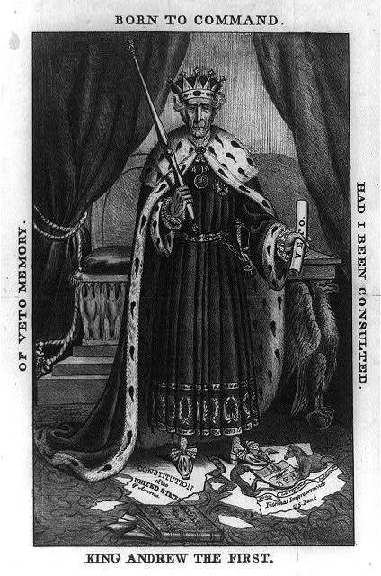
What are Primary Sources?
Original records of people, places, and events.
Examples include:
  Documents
  Photos
  Drawings
  Maps
  Music
  Video/Film
  Political Cartoons

Slide 10
What are Secondary Sources?
Summaries
Re-tellings
Not Eye Witness Accounts – one or more steps removed from the event
Interpretations / Analysis

Slide 11

Finding Primary Sources Online
Google or some other search engine?
Library of Congress
Archives and Museums

Slide 12

Organizing Primary Sources through Curation
I’ve found primary sources – now what?
Curation tools are like the old vertical files.
Keyword indexing is important!
Once you start curating, you can’t stop!
https://www.youtube.com/watch?v=p3wMwNxgcTU

Slide 13
Examples of Primary Source Activities Linked to Common Core Standards

Slide 14
Questions?
Dr. David W. McMullen
  mcmullen@fsmail.bradley.edu
Dr. Sherrie C. Pardieck
  sherrie@fsmail.bradley.edu
Dr. Dean A. Cantu
  dcantu@fsmail.bradley.edu

